Slide 1
SMOKING AND DRINKING ANALYSIS WITH BODY SIGNAL
ANAKHA AJKUMAR
MSC CS(DA)-07
PYTHON

Slide 2
INTRODUCTION
The "Smoking and Drinking" dataset is a collection of health-related data containing information about various aspects of individuals' health and behaviors. This dataset encompasses data on demographics, physical measurements, medical parameters, and lifestyle choices such as smoking and drinking habits. Their are 991346 rows and24 columns of data. They are:
Sex
Age
Height
Weight
Sight_left
Sight_right
Hear_left
Hear_right
SBP
DBP
BLDS
tot_chole
HDL_chole
LDL_chole
Triglycerid
Hemoglobin
Urine_protein
Serum_creatinine
SGOT_AST
SGOT_ALT
gamma_GTP
SMK_stat_type_cd
DRK_YN

Slide 3
OBJECTIVE
Smoking and drinking with body signals serves as a valuable resource for health-related research,enabling the analysis of body signals and the classification of individuals based on their smoking and drinking behaviors. It supports various objectives, including understanding health trends, assessing risk factors, promoting public health, and aiding in the development of data-driven interventions.

Slide 4
Steps in Analysing Dataset
01
02
03
Data Preprocessing
Data Visualization
Data Modeling
cleaning, changing,and
reducing data
To help find pattern,
trend and relationship
Using various models,make predictions
To help find pattern,trend and relationship
04
Inferences
Making inferences from
the dataset

Slide 5
PREPROCESSING
Check whether the attributes are balanced using a bar chart.
Detect and handle outliers in numerical features using Z-score
Convert categorical into numerical to improve the accuracy
Remove duplicate values and the least correlated column
Scale the numerical attributes with Standard Scaler function

Slide 6
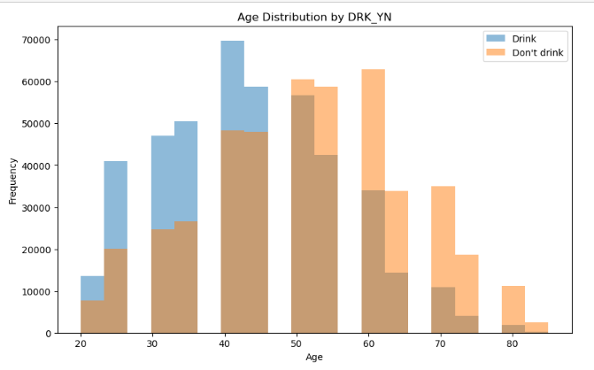
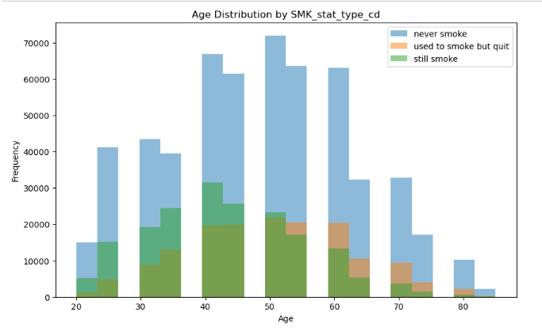
VISUALIZATION
Age distribution Vs drinking Age distribution Vs Smoking

Slide 7
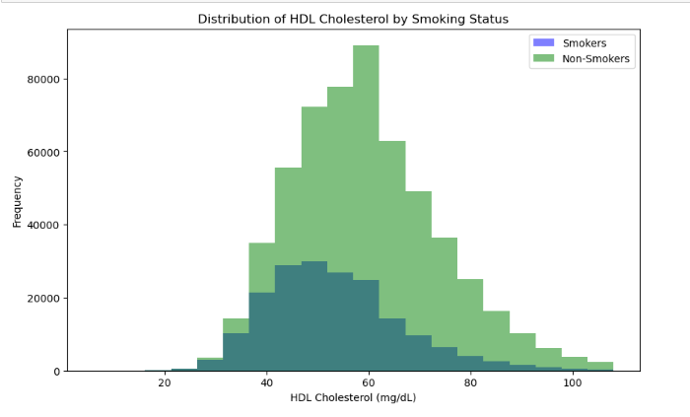
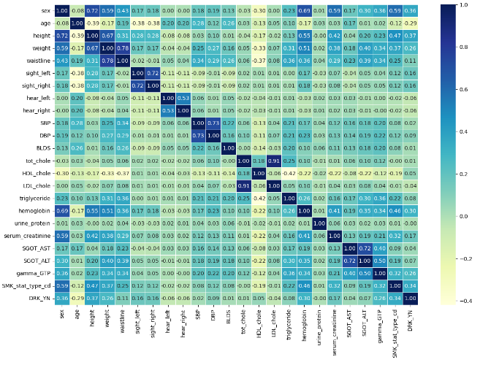
Continue…
HDL Cholestrol Vs Smoking Correlation Matrix

Slide 8
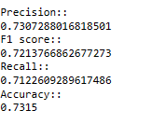
MODELING
1)Logistic Regression
It is a type of generalized linear model in which a logistic function s used to model the relationship between the independent variables and the dependent variable.The dependent variable in logistic regression is a binary, and the independent variables can be either continuous or categorical.

Slide 9
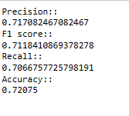
2) RandomForest
The random forest is a classifier that takes the average of a number of decision trees on different parts of a given dataset to improve the accuracy of that dataset's predictions.

Slide 10
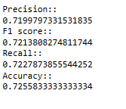
3) Gradient Boosting
Gradient Boosting is a powerful and popular machine learning technique used for both regression and classification tasks. It belongs to the ensemble learning family, which combines multiple weak learners (often decision trees) to create a strong predictive model. It is robust against overfitting because it builds models sequentially, and each new model corrects the errors of the previous ones.

Slide 11
CONCLUSION
Logistic Regression is the best model to classify the target in smoking with body signal with
73.1%.
Smoking doesn't much to cholesterol
Smoking and Drinking have some correlation

Slide 12
THANK YOU

